Slide 1

Pictoword
Ishita jindal
2110993799
Kangna
2110993804

Slide 2


CONTENT
Introduction
Brief of code
Modules used
Sound/Music
Cover Page
Instructions
Main Code

Slide 3
Introduction
Pictoword - a simple yet addictive word game where you "read" a series of pictures that combine to create a word!
In Pictoword, the player will “read” two pictures to form a word. The puzzles can be a combination of the pictures.
For example:-A picture of an ear and ring will form Earring), a homonym (A picture of a knight and mare will form Nightmare) .
The user will be rewarded and ranks will be calculated on the basics of their performance.

Slide 4
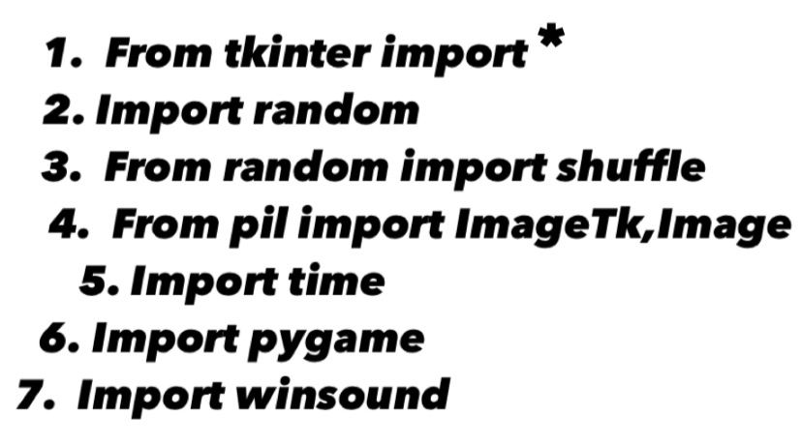
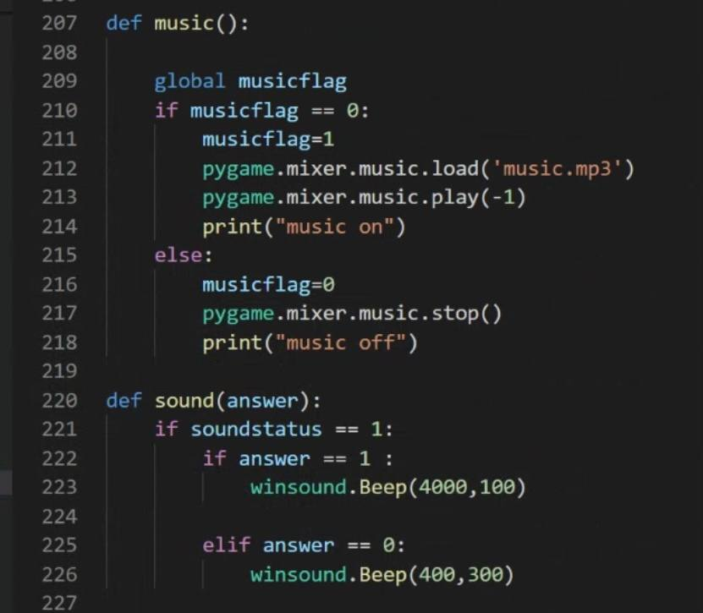
BRIEF OF CODE
MODULES USED:
SOUND/MUSIC

Slide 5
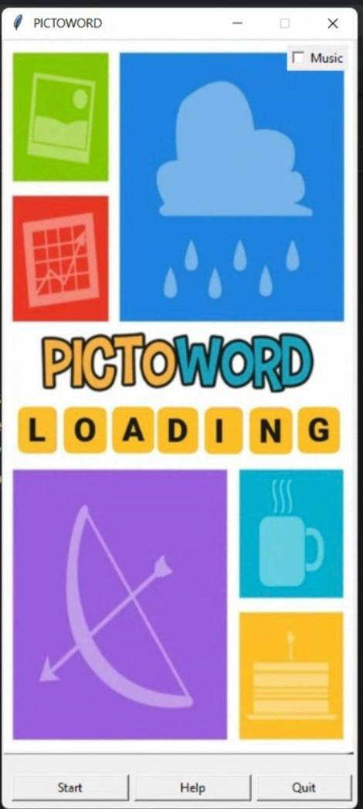
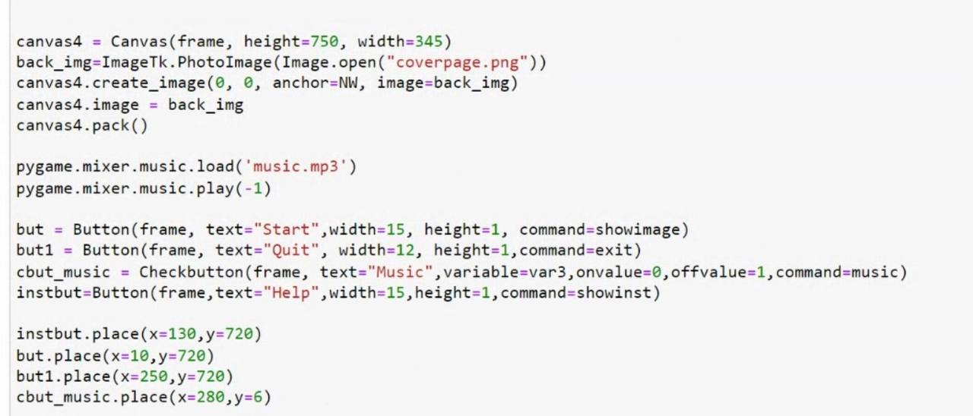
COVER PAGE

Slide 6
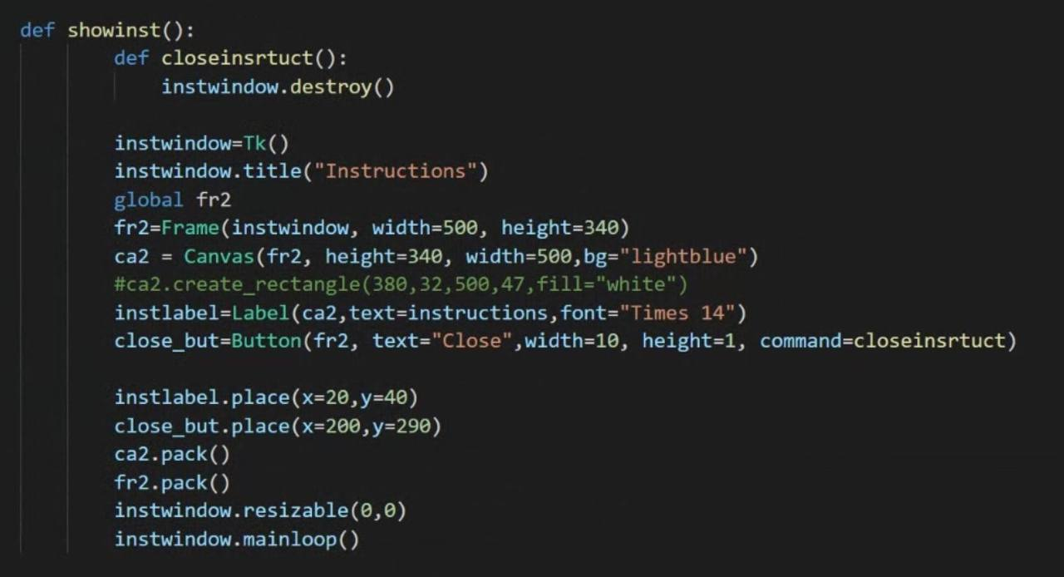
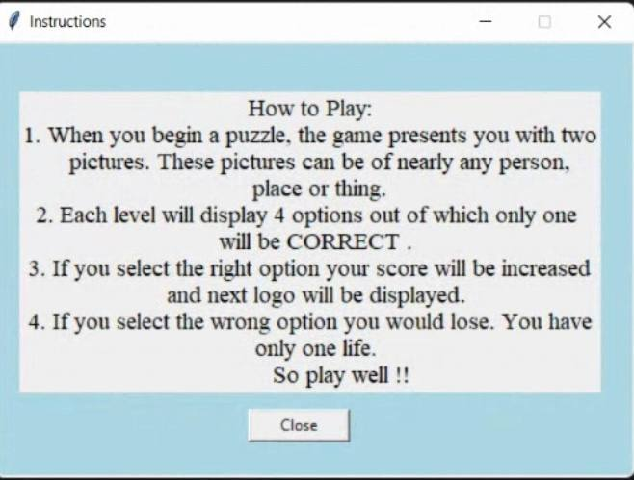
INSTRUCTIONS

Slide 7
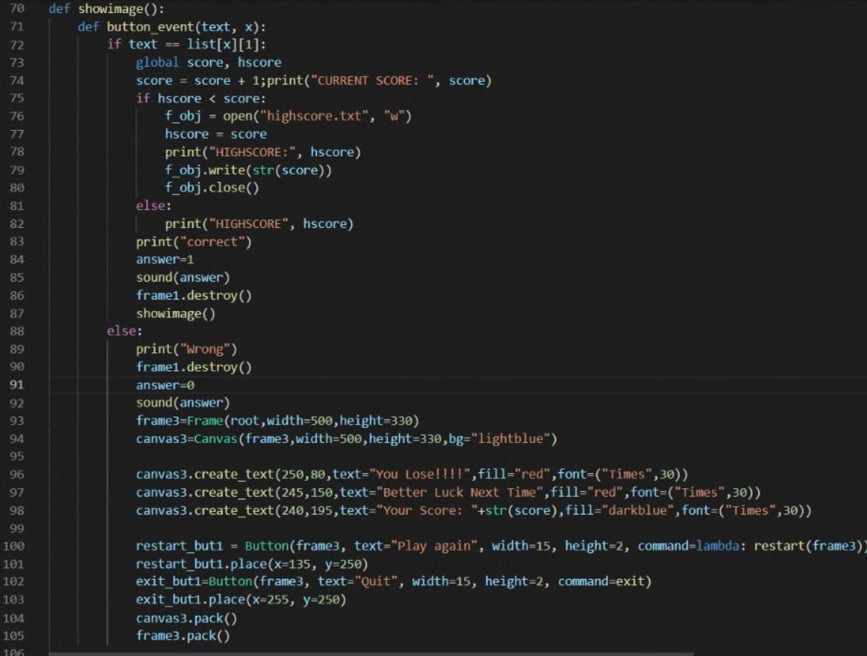
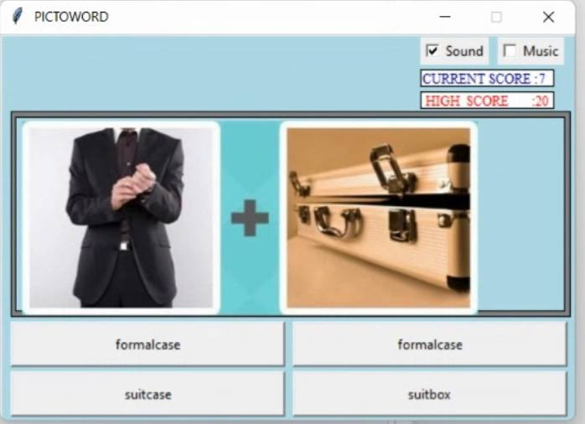
Main code

Slide 8
Thank you

